Slide 1
Introduction to STL

Slide 2
Standard Template Library
The heart of the C++ standard library is the standard template library (STL).
STL is a generic library that provides solutions to managing collections of data with modern and efficient algorithms.
  It provides a bunch of collection classes that meet different needs, together with several algorithms that operate on them.
  All components of STL are templates, so they can be used for arbitrary element types.
STL components:
  Containers: used to manage collections of objects of a certain kind
  Iterators: used to step through the elements of collections of objects
  Algorithms: used to process the elements of collections, e.g., search, sort, modify, etc. Algorithms use iterators.

Slide 3
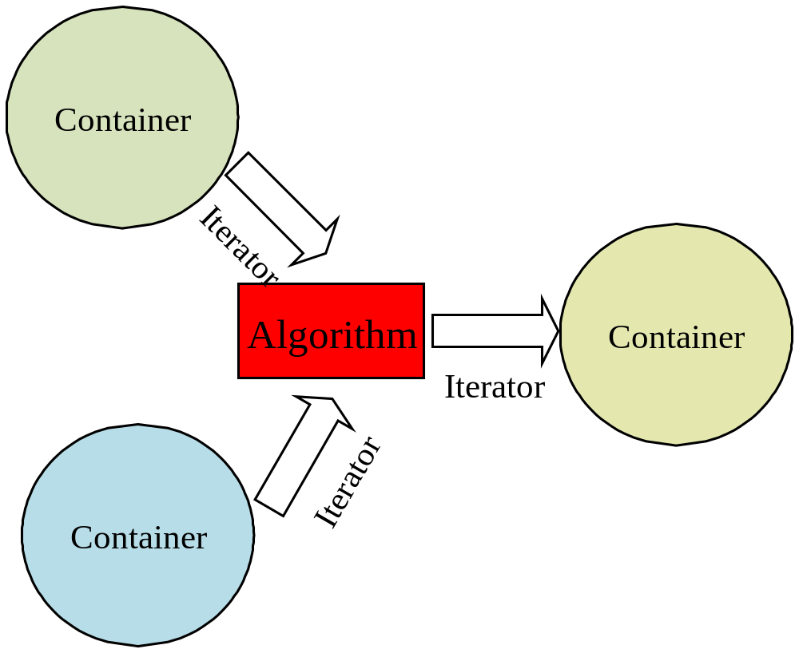
Standard Template Library

Slide 4
Containers
Containers are used to store and manage objects of a certain kind (such as int, double, string, etc.)
STL provides different kinds of containers to meeting different needs
  Sequence containers
    Ordered collections – every element has a certain position that depends on the time and place of the insertion
    vector, deque, list, string
  Associative containers
    Sorted collections – the position of an element depends on its value due to a certain sorting criterion
    set, multiset, map, multimap

Slide 5
Container Adapters
STL also provides special predefined container adapters that meet special needs
  stack, queue, priority_queue
These adapters use the general framework of containers, iterators, and algorithms

Slide 6
Iterators
An iterator is an object that can “iterate” (navigate) over the elements of an STL container.
  Question: what is the data type of iterator?
An iterator represents a certain position in a container. It supports the following operators
  Operator *
    Returns the element of the current position
  Operators ++ and --
    Lets the iterator step forward or backward to the next element
  Operators == and !=
    Return whether two iterators represent the same position
  Operator =
    Assigns an iterator

Slide 7
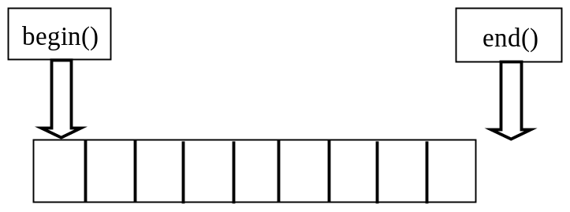
Iterators (cont.)
Each container defines two iterator types
  container::iterator – used for read/write mode
  container::const_iterator – used for read-only mode
  Remark: container should be replaced by the name of the container class, e.g., vector<int>::iterator, deque<string>::const_iterator
All container classes provide the same basic member functions to return iterators
  begin()
    Returns an iterator that represents the beginning of the elements in the container
  end()
    Returns an iterator that represents the end of the elements in the container. The end is the position behind the last element.

Slide 8
Example
#include <iostream>
#include <vector>
#include <numeric>
using namespace std;
int main()
{
vector<int> v;
int i;
for (i = 0; i < 10; i++)
v.push_back(i);
for (vector<int>::iterator it = v.begin(); it != v.end(); it++)
cout << *it << “ ”;
cout << endl;
cout << accumulate(v.begin(), v.end(), 0) << endl;
return 0;
}
vector used to store integers
Iterator used to access an integer in vector
an algorithm to sum up a sequence of items

Slide 9
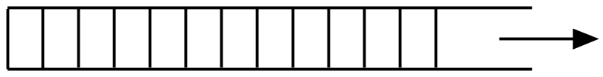
(I) vector
Vector
  manages its elements in a dynamic array
  enables random access
  Appending and removing elements at the end of the array is very fast
  Inserting and element in the middle or at the beginning of the array takes time
http://www.cplusplus.com/reference/stl/vector

Slide 10
Vector Example
// vector1.cpp
#include <iostream>
#include <vector>
using namespace std;
int main()
{
vector<int> coll;
for (int i = 1; i <= 6; ++i)
coll.push_back(i);
for (int i = 0; i < coll.size(); ++i)
cout << coll[i] << “ “;
cout << endl;
return 0;
}
The output will be:
1 2 3 4 5 6

Slide 11
Important methods
begin(): return iterator to beginning
end(): return iterator to one after the last element
push_back(): add element at the end
insert(): insert elements at some position
erase(): erase elements at some range
clear(): remove all elements
size(): return the number of elements
empty(): test whether vector is empty

Slide 12
Vector Creation
Create an empty vector
  vector<int> v;
Specify the size of the vector
  vector<double> v(20);
  /* 20 items, all initialized to 0 */
Specify the size and initial value
  vector<double> v(20, 1.0);
  /* 20 items, all initialized to 1.0 */

Slide 13
Add a new element at the end
push_back()
#include <vector>
using namespace std;
int main()
{
vector<int> v;
v.push_back(5);
v.push_back(8);
v.push_back(2);
return 0;
}
push_bakc() can automatically
allocate memory.
The vector will contain three integers at the end: 5, 8, 2

Slide 14
Access vector like an array
#include <iostream>
#include <vector>
using namespace std;
int main()
{
vector<int> v(3);
v[0] = 5;
v[1] = 8;
v[2] = 2;
cout << v[0] << “ “ << v[1] << “ “ << v[2] << endl;
return 0;
}
Remark: make sure the vector has enough space when using [].
Overflow will make your program crash.

Slide 15
Use iterator to access vector
#include <iostream>
#include <vector>
using namespace std;
int main()
{
vector<int> v(3);
v[0] = 5;
v[1] = 8;
v[2] = 2;
vector<int>::iterator it;
for( it = v.begin(); it != v.end(); it++)
cout << *it << “ “;
cout << endl;
return 0;
}

Slide 16
Insert elements by insert() http://www.cplusplus.com/reference/stl/vector/insert/
#include <iostream>
#include <vector>
using namespace std;
int main()
{
vector<int> v(3);
v[0] = 5;
v[1] = 8;
v[2] = 2;
v.insert(v.begin(), 7);
v.insert(v.begin() + 2, 1);
v.insert(v.end(), 3);
vector<int>::iterator it;
for( it = v.begin(); it != v.end(); it++)
cout << *it << “ “;
cout << endl;
return 0;
}
The output will be:
7 5 1 8 2 3

Slide 17
Delete elements by erase() http://www.cplusplus.com/reference/stl/vector/erase/
#include <iostream>
#include <vector>
using namespace std;
int main()
{
vector<int> v(10);
for (int i = 0; i < 10; i++)
v[i] = i;
// erase a single element
v.erase(v.begin()+2);
vector<int>::iterator it;
for( it = v.begin(); it != v.end(); it++)
cout << *it << “ “;
cout << endl;
// erase a range: [1, 5)
v.erase(v.begin()+1, v.begin()+5);
for( it = v.begin(); it != v.end(); it++)
cout << *it << “ “;
cout << endl;
return 0;
}
The output will be:
0 1 3 4 5 6 7 8 9
0 6 7 8 9
Remark:
When erasing a range, the
first location will be erased
but the last one won’t.

Slide 18
Reverse the elements http://www.cplusplus.com/reference/algorithm/reverse/
reverse() is an algorithm, not a method
#include <iostream>
#include <vector>
#include <algorithm>
using namespace std;
int main()
{
vector<int> v(10);
for (int i = 0; i < 10; i++)
v[i] = i;
reverse(v.begin(), v.end());
vector<int>::iterator it;
for( it = v.begin(); it != v.end(); it++)
cout << *it << “ “;
cout << endl;
return 0;
}
The output will be:
9 8 7 6 5 4 3 2 1 0

Slide 19
Sort the elements http://www.cplusplus.com/reference/algorithm/sort/
sort() is an algorithm, not a method
#include <iostream>
#include <vector>
#include <algorithm>
using namespace std;
int main()
{
vector<int> v;
for (int i = 0; i < 10; i++)
v.push_back(9-i);
for (i = 0; i < 10; i++)
cout << v[i] << “ “;
cout << endl;
sort(v.begin(), v.end());
for (i = 0; i < 10; i++)
cout << v[i] << “ “;
cout << endl;
return 0;
}
The output will be:
9 8 7 6 5 4 3 2 1 0
0 1 2 3 4 5 6 7 8 9
Question:
Why do we use
“vector<int> v;” here, instead of
“vector<int> v(10);” ?

Slide 20
Sort as you wish
By default, sort() follows the ascending order
But you can specify how to sort!
#include <iostream>
#include <vector>
#include <algorithm>
using namespace std;
/* design your own comparison function */
bool Comp(const int &a, const int &b)
{
return a > b;
}
int main()
{
vector<int> v;
for (int i = 0; i < 10; i++)
v.push_back(i);
for (i = 0; i < 10; i++)
cout << v[i] << “ “;
cout << endl;
sort(v.begin(), v.end(), Comp);
for (i = 0; i < 10; i++)
cout << v[i] << “ “;
cout << endl;
sort(v.begin(), v.end());
for (i = 0; i < 10; i++)
cout << v[i] << “ “;
cout << endl;
return 0;
}
The output will be:
0 1 2 3 4 5 6 7 8 9
9 8 7 6 5 4 3 2 1 0
0 1 2 3 4 5 6 7 8 9

Slide 21
Size of a vector
#include <iostream>
#include <vector>
using namespace std;
int main()
{
vector<int> v(10);
for (int i = 0; i < 10; i++)
v[i] = i;
/* the number of elements */
cout << v.size() << endl;
/* is the vector empty? */
cout << v.empty() << endl;
/* remove all elements */
v. clear();
/* is the vector empty? */
cout << v.empty() << endl;
return 0;
}
The output will be:
10
0
1

Slide 22
(II) string
http://www.cplusplus.com/reference/string/string/
C++ string class is designed like a fundamental data type
To create an empty string
#include <iostream>
#include <string>
using namespace std;
int main()
{
string s;
cout << s.length() << endl;
return 0;
}
The output will be:
0

Slide 23
Assign value to string
/* assign a string directly */
#include <iostream>
#include <string>
using namespace std;
int main()
{
string s;
s = “Hello, HKBU.”; // a space in the middle
cout << s << endl;
cout << s.length() << endl;
return 0;
}
/* read in a string by scanf() */
#include <iostream>
#include <string>
using namespace std;
int main()
{
string s;
char ss[100];
scanf(“%s”, &ss);
s = ss;
cout << s << endl;
cout << s.length() << endl;
return 0;
}
The output will be:
Hello, HKBU.
12
Example output:
How are you?
How
3

Slide 24
Append string to string
/* use operator + */
#include <iostream>
#include <string>
using namespace std;
int main()
{
string s;
s = s + “abc”;
s = s + “123”;
cout << s << endl;
return 0;
}
/* use append() */
#include <iostream>
#include <string>
using namespace std;
int main()
{
string s;
s.append(“abc”);
s.append(“123”);
cout << s << endl;
return 0;
}
The output will be:
abc123
The output will be:
abc123
Remark: you can also append a character as follows:
s = s + ‘a’;

Slide 25
Insert characters by insert()
#include <iostream>
#include <string>
using namespace std;
int main()
{
string s;
s = “123456”;
string::iterator it;
it = s.begin();
/* insert a single p */
s.insert(it + 1, ‘p’);
cout << s << endl;
return 0;
}
#include <iostream>
#include <string>
using namespace std;
int main()
{
string s;
s = “123456”;
string::iterator it;
it = s.begin();
/* insert 3 p */
s.insert(it + 1, 3, ‘p’);
cout << s << endl;
return 0;
}
Remark:
You cannot insert
a string into a string
by insert()!
The output will be:
1p23456
The output will be:
1ppp23456

Slide 26
Delete characters by erase()
#include <iostream>
#include <string>
using namespace std;
int main()
{
string s;
s = “abc123456”;
string::iterator it = s.begin();
s.erase(it + 3);
cout << s << endl;
s.erase(it, it+4);
cout << s << endl;
return 0;
}
The output will be:
abc23456
3456

Slide 27
Replace characters by replace()
#include <iostream>
#include <string>
using namespace std;
int main()
{
string s;
s = “abc123456”;
/* replace 2 characters, from s[3], by good */
s.replace(3, 2, “good”);
cout << s << endl;
return 0;
}
The output will be:
abcgood3456

Slide 28
Search in a string by find()
#include <iostream>
#include <string>
using namespace std;
int main()
{
string s;
s = “cat dog cat”;
cout << s.find(‘c’) << endl;
cout << s.find(“c”) << endl;
cout << s.find(“cat”) << endl;
cout << s.find(“dog”) << endl;
cout << s.find(“dogc”) << endl;
return 0;
}
find() returns the position of the first occurrence in the string.
If the content is not found, the member value npos is returned.
The output will be:
0
0
0
4
4294967295

Slide 29
String comparison by compare()
#include <iostream>
#include <string>
using namespace std;
int main()
{
string s;
s = “cat dog cat”;
cout << s.compare(“cat”) << endl;
cout << s.compare(“cat dog cat”) << endl;
cout << s.compare(“dog”) << endl;
return 0;
}
The output will be:
1
0
-1

Slide 30
Transform a string
#include <iostream>
#include <string>
#include <algorithm>
#include <cctype>
using namespace std;
int main()
{
string s(“The zip code of Beijing is 100000”);
cout << “original: “ << s << endl;
// lowercase all characters
transform(s.begin(), s.end(), // source
s.begin(), // destination
tolower); // operation
cout << “lowered: “ << s << endl;
// uppercase all characters
transform(s.begin(), s.end(), // source
s.begin(), // destination
toupper); // operation
cout << “uppered: “ << s << endl;
return 0;
}
The output will be:
original: The zip code of Beijing is 100000
lowered: the zip code of beijing is 100000
uppered: THE ZIP CODE OF BEIJING IS 100000

Slide 31
Compare and search strings in a case-insensitive way
#include <iostream>
#include <string>
#include <algorithm>
using namespace std;
bool nocase_compare(char c1, char c2) {
return toupper(c1) == toupper(c2);
}
int main()
{
string s1(“This is a string”);
string s2(“STRING”);
// compare case insensitive
if (s1.size() == s2.size() && // ensure same sizes
equal(s1.begin(), s1.end(), // first source string
s2.begin(), // second source string
nocase_compare) ) // comparions criterion
cout << “the strings are equal” << endl;
else
cout << “the strings are not equal” << endl;

Slide 32
(Cont.)
// search case insensitive
string::iterator pos;
pos = search (s1.begin(), s1.end(), // source string in which to search
s2.begin(), s2.end(), //substring to search
nocase_compare); // comparison criterion
if (pos == s1.end())
cout << s2 << " is not a substring of " << s1 << endl;
else
cout << s2 << " is a substring of " << s1 << endl;
return 1;
}
The output will be:
The strings are not equal
STRING is a substring of This is a string

Slide 33
Handle more strings
We can store a number of strings in a vector
#include <vector>
#include <iostream>
#include <string>
using namespace std;
int main()
{
vector<string> v;
v.push_back(“Jack”);
v.push_back(“Mike”);
v.push_back(“Tom”);
cout << v[0] << endl;
cout << v[1] << endl;
cout << v[2] << endl;
cout << v[0][0] << endl;
cout << v[1][0] << endl;
cout << v[2].length() << endl;
return 0;
}
The output will be:
Jack
Mike
Tom
J
M
3

Slide 34
Example 1 http://acm.zjut.edu.cn #1044
Description: 有一些01字串，将其按1的个数的多少的顺序进行输出。
Sample Input:
10011111
00001101
1010101
1
0
1100
Sample Output:
0
1
1100
00001101
1010101
10011111
Remark:
Use a vector of string to hold all input
Write your own comparison function
Sort the vector based on the number
of 1s

Slide 35
Solution
#include <vector>
#include <iostream>
#include <string>
#include <algorithm>
using namespace std;
bool myComp(const string &s1, const string &s2) {
int c1 = count(s1.begin(), s1.end(), ‘1’);
int c2 = count(s2.begin(), s2.end(), ‘1’);
return c1 < c2;
}
int main()
{
vector<string> v;
string s;
while (cin >> s)
v.push_back(s);
sort(v.begin(), v.end(), myComp);
vector<string>::iterator it;
for(it = v.begin(); it != v.end(); it++)
cout << *it << endl;
return 0;
}

Slide 36
Example 2 http://acm.zjut.edu.cn #1208
Description:
  很多字串，有些是对称的，有些是不对称的，请将那些对称的字串按从小到大的顺序输出。字串先以长度论大小，如 果长度相同，再以ASCII码值为大小标准。
Input:
  输入数据中含有一些字串（1≤串长≤256）。
Output:
  根据每个字串，输出对称的那些串，并且要求按从小到大的顺序输出。
Sample Input:
123321
123454321
123
321
sdfsdfd
121212
\\dd\\
Sample Output:
123321
\\dd\\
123454321

Slide 37
Solution
#include <iostream>
#include <string>
#include <vector>
#include <algorithm>
using namespace std;
bool Comp(const string &s1, const string &s2)
{
return s1.length() != s2.length() ? s1.length() < s2.length() : s1 < s2;
}
int main()
{
vector<string> v;
string t, s;
while (cin >> s) {
t = s;
reverse(t.begin(), t.end());
if (t == s)
v.push_back(s);
}
sort(v.begin(), v.end(), Comp);
for( int i = 0; i < v.size(); i++)
cout << v[i] << endl;
return 0;
}

Slide 38

(III) deque
deque is an abbreviation for “double-ended queue”
  A dynamic array that can grow in both directions
  Inserting elements at the end and at the beginning is fast
  Inserting elements in the middle takes time
http://www.cplusplus.com/reference/stl/deque

Slide 39
Deque Example
// deque1.cpp
#include <iostream>
#include <deque>
using namespace std;
int main()
{
deque<float> coll;
for (int i = 1; i <= 6; ++i)
coll.push_front(i*1.1);
for (int i = 0; i < coll.size(); ++i)
cout << coll[i] << ' ';
cout << endl;
return 0;
}
$ g++ deque1.cpp
$ ./a.out
6.6 5.5 4.4 3.3 2.2 1.1
$

Slide 40
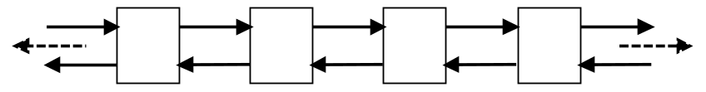
(IV) list
List is implemented as a doubly linked list of elements
  Each element in a list has its own segment of memory and refers to its predecessor and its successor
  Disadvantage: Lists do not provide random access. General access to an arbitrary element takes linear time.
    Hence lists don’t support the [ ] operator
  Advantage: insertion or removal of an element is fast at any position
http://www.cplusplus.com/reference/stl/list/

Slide 41
List Example 1
// list1.cpp
#include <iostream>
#include <list>
using namespace std;
int main()
{
list<char> coll;
for (char c = 'a'; c <= 'z'; ++c)
coll.push_back(c);
while (! coll.empty() ) {
cout << coll.front() << ' ';
coll.pop_front();
}
cout << endl;
return 0;
}
$ g++ list1.cpp
$ ./a.out
a b c d e f g h i j k l m n o p q r s t u v w x y z
$

Slide 42
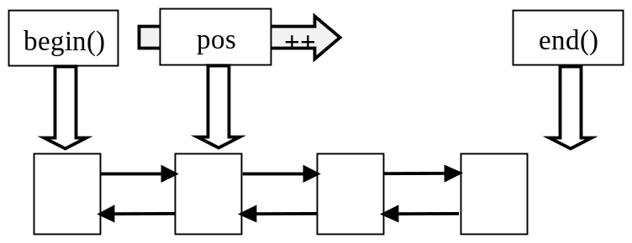
List Example 2
// list2.cpp
#include <iostream>
#include <list>
using namespace std;
int main()
{
list<char> coll;
for (char c='a'; c<='z'; ++c)
coll.push_back(c);
list<char>::const_iterator pos;
for (pos = coll.begin(); pos != coll.end(); ++pos)
cout << *pos << ' ';
cout << endl;
}
$ g++ list2.cpp
$ ./a.out
a b c d e f g h i j k l m n o p q r s t u v w x y z
$

Slide 43
List Example 3
// list3.cpp
#include <iostream>
#include <list>
using namespace std;
int main()
{
list<char> coll;
for (char c='a'; c<='z'; ++c)
coll.push_back(c);
list<char>::iterator pos;
for (pos = coll.begin(); pos != coll.end(); ++pos) {
*pos = toupper(*pos);
cout << *pos << ' ';
}
cout << endl;
}

Slide 44
Associative Containers
Associative containers sort their elements automatically according to a certain ordering criterion
  By default, the containers compare the elements with operator <
  You can supply your own comparison function to define another ordering criterion
Examples will be given later, after introducing iterators

Slide 45
Associative Containers
Sets
  A set is a collection in which elements are sorted according to their own values. Duplicates are not allowed.
Multisets
  A multiset is the same as a set except that duplicates are allowed.
Maps
  A map contains elements that are key/value pairs. Each element has a key that is the basis for the sorting criterion and a value. Duplicate keys are not allowed.
Multimaps
  A multimap is the same as a map except that duplicate keys are allowed.
  Can also be used as dictionary.

Slide 46
(V) set
http://www.cplusplus.com/reference/stl/set/
A set maintains a sequence of elements sorted in an order (ascending by default)
  Implemented by a balanced binary search tree
  Good for search

Slide 47
Insert elements into a set
#include <iostream>
#include <set>
using namespace std;
int main()
{
set<int> coll;
/* insert 1 to 6 in arbitrary order
* 1 gets inserted twice
*/
coll.insert(3);
coll.insert(1);
coll.insert(5);
coll.insert(4);
coll.insert(1);
coll.insert(6);
coll.insert(2);
set<int>::const_iterator pos;
for (pos = coll.begin(); pos != coll.end(); ++pos)
cout << *pos << ' ';
cout << endl;
return 0;
}
Remark:
All associative containers provide an insert() member function.
You cannot use push_back() or push_front() because you can’t specify the position of the new element.
Duplicates are not allowed in a set.
The output will be:
1 2 3 4 5 6

Slide 48
Reverse traversal of a set
#include <iostream>
#include <set>
using namespace std;
int main()
{
set<int> s;
s.insert(8);
s.insert(1);
s.insert(12);
s.insert(6);
s.insert(8);
set<int>::reverse_iterator rit;
for (rit = s.rbegin(); rit!= s.rend(); ++rit)
cout << *rit << ' ';
cout << endl;
return 0;
}
The output will be:
12 8 6 1

Slide 49
Delete an element in a set
#include <iostream>
#include <set>
using namespace std;
int main()
{
set<int> s;
s.insert(8);
s.insert(1);
s.insert(12);
s.insert(6);
s.insert(8);
s.erase(6);
set<int>::reverse_iterator rit;
for (rit = s.rbegin(); rit!= s.rend(); ++rit)
cout << *rit << ' ';
cout << endl << s.size() << endl;
return 0;
}
The output will be:
12 8 1
3

Slide 50
Search in a set by find()
#include <iostream>
#include <set>
using namespace std;
int main()
{
set<int> s;
s.insert(8);
s.insert(1);
s.insert(12);
s.insert(6);
s.insert(8);
set<int>::iterator it;
it = s.find(6);
if (it != s.end()) cout << *it << endl;
else cout << “not find it” << endl;
it = s.find(20);
if (it != s.end()) cout << *it << endl;
else cout << “not find it” << endl;
return 0;
}
Remark:
Search in a set is very
efficient.
The output will be:
6
not find it

Slide 51
Define your own order
Two methods
  If the element of the set is not a structure or class, you need to provide a comparison function
  If the element of the set is a structure or class, you can overload the < operator for the element data type

Slide 52
Example 1
#include <iostream>
#include <set>
using namespace std;
struct myComp {
bool operator()(const int &a, const int &b) {
return a > b;
}
};
int main()
{
set<int, myComp> s;
s.insert(8);
s.insert(1);
s.insert(12);
s.insert(6);
s.insert(8);
set<int, myComp>::iterator it;
for( it = s.begin(); it != s.end(); it++)
cout << *it << ' ';
cout << endl;
return 0;
}
The output will be:
12 8 6 1

Slide 53
Example 2
#include <iostream>
#include <string>
#include <set>
using namespace std;
struct Info {
string name;
float score;
bool operator < (const Info &a) const {
return a.score < score;
}
};
int main()
{
set<Info> s; Info a;
a.name = “Jack”; a.score = 80;
s.insert(a);
a.name = “Tom”; a.score = 70;
s.insert(a);
a.name = “Mary”; a.score = 85;
a.insert(a);
set<stu>::iterator it;
for( it = s.begin(); it != s.end(); it++)
cout << (*it).name << “: “ << (*it).score << endl;
cout << endl;
return 0;
}
The output will be:
Mary: 85
Jack: 80
Tom: 70

Slide 54
(VI) Multiset http://www.cplusplus.com/reference/stl/multiset/
#include <iostream>
#include <set>
#include <string>
using namespace std;
int main()
{
multiset<string> ms;
ms.insert(“abc”);
ms.insert(“123”);
ms.insert(“111”);
ms.insert(“aaa”);
ms.insert(“123”);
multiset<string>::iterator it;
for (it = ms.begin(); it!= ms.end(); ++it)
cout << *it << endl;
return 0;
}
The output will be:
111
123
123
aaa
abc

Slide 55
Delete element by erase()
#include <iostream>
#include <set>
#include <string>
using namespace std;
int main()
{
multiset<string> ms;
ms.insert(“abc”);
ms.insert(“123”);
ms.insert(“111”);
ms.insert(“aaa”);
ms.insert(“123”);
multiset<string>::iterator it;
for (it = ms.begin(); it!= ms.end(); ++it)
cout << *it << endl;
int n = ms.erase(“123”);
cout << “Total deleted: “ << n << endl;
for (it = ms.begin(); it!= ms.end(); ++it)
cout << *it << endl;
return 0;
}
The output will be:
111
123
123
aaa
abc
Total deleted: 2
111
aaa
abc

Slide 56
Search element by find()
#include <iostream>
#include <set>
#include <string>
using namespace std;
int main()
{
multiset<string> ms;
ms.insert(“abc”);
ms.insert(“123”);
ms.insert(“111”);
ms.insert(“aaa”);
ms.insert(“123”);
multiset<string>::iterator it;
it = ms.find(“123”);
if (it != ms.end()) // bingo
cout << *it << endl;
else
cout << “not find it” << endl;
return 0;
}
find() will return an iterator to one of
the elements with that value, if such
an element is found,
or multiset::end() if the specified
Value is not found in the container.
The output will be:
123

Slide 57
Example: http://acm.zjut.edu.cn #1204
Description:
  将01串首先按长度排序，长度相同时，按1的个数多少进行排序，1的个数相同时再按ASCII码值排序。
Input:
  输入数据中含有一些01串，01串的长度不大于256个字符。
Output:
  重新排列01串的顺序。使得串按基本描述的方式排序。
Sample Input:
10011111
00001101
1010101
1
0
1100
Sample Output:
0
1
1100
1010101
00001101
10011111

Slide 58
Solution
#include <iostream>
#include <string>
#include <set>
#include <algorithm>
using namespace std;
struct Comp {
bool operator () (const string &s1, const string &s2) {
if (s1.length() != s2.length())
return s1.length() < s2.length();
int c1 = count(s1.begin(), s1.end(), '1');
int c2 = count(s2.begin(), s2.end(), '1');
return c1 != c2 ? c1 < c2 : s1 < s2;
}
};
int main()
{
multiset<string, Comp> ms;
string s;
while (cin >> s)
ms.insert(s);
multiset<string, Comp>::iterator it;
for(it = ms.begin(); it != ms.end(); it++)
cout << *it << endl;
return 0;
}

Slide 59
(VII) map
http://www.cplusplus.com/reference/stl/map/
Maps are a kind of associative containers that stores elements formed by the combination of a key value and a mapped value.
  designed to be efficient accessing elements by their key value
In a map, the key value is generally used to uniquely identify the element, while the mapped value is some sort of value associated to this key.
  a typical example of a map is a telephone guide where the name is the key value and the telephone number is the mapped value.

Slide 60
Map creation and traversal
#include <iostream>
#include <map>
#include <string>
using namespace std;
int main()
{
map<string, float> m;
m[“Jack”] = 98.5;
m[“Bob”] = 96.0;
m[“Kate”] = 97.5;
map<string, float>::iterator it;
for(it = m.begin(); it != m.end(); it++)
cout << (*it).first << “ : “ << (*it).second << endl;
return 0;
}
Remark:
Elements are key/value pairs.
The iterators refer to key/value pair. You must access the members of the pair structure.
The output will be:
Bob : 96.0
Jack : 98.5
Kate: 97.5

Slide 61
Another Example of Map
#include <iostream>
#include <map>
#include <string>
using namespace std;
int main()
{
typedef map<string, float> StringFloatMap;
StringFloatMap coll;
coll.insert(make_pair("MAP", 1.23));
coll["VAT"] = 0.15;
coll["Pi"] = 3.1415;
coll["an arbitrary number"] = 4983.223;
coll["Null"] = 0;
StringFloatMap::iterator pos;
for (pos = coll.begin(); pos != coll.end(); ++pos) {
cout << "key: \"" << pos->first << "\" "
<< "value: " << pos->second << endl;
}
return 0;
}
Remark:
This example shows a
different way to insert
an element:
make_pair() & insert()
The output will be:
key: "MAP" value: 1.23
key: "Null" value: 0
key: "Pi" value: 3.1415
key: "VAT" value: 0.15
key: "an arbitrary number" value: 4983.22

Slide 62
Delete element from map
#include <iostream>
#include <map>
using namespace std;
int main()
{
map<int, char> m;
m[25] = ‘m’;
m[28] = ‘k’;
m[10] = ‘x’;
m[30] = ‘a’;
m.erase(28);
map<int, char>::iterator it;
for(it = m.begin(); it != m.end(); it++)
cout << (*it).first << “ : “ << (*it).second << endl;
return 0;
}
The output will be:
10 : x
25 : m
30 : a

Slide 63
Find an element by find()
#include <iostream>
#include <map>
using namespace std;
int main()
{
map<int, char> m;
m[25] = ‘m’;
m[28] = ‘k’;
m[10] = ‘x’;
m[30] = ‘a’;
map<int, char>::iterator it;
it = m.find(28);
if (it != m.end() )
cout << (*it).first << “ : “ << (*it).second << endl;
else
cout << “not found it “ << endl;
return 0;
}
The output will be:
28 : k

Slide 64
Example http://acm.zju.edu.cn #2104
Contest time again! How excited it is to see balloons floating around. But to tell you a secret, the judges' favorite time is guessing the most popular problem. When the contest is over, they will count the balloons of each color and find the result.
This year, they decide to leave this lovely job to you.
Input
Input contains multiple test cases. Each test case starts with a number N (0 < N < 1000) -- the total number of balloons distributed. The next N lines contain one color each. The color of a balloon is a string of up to 15 lower-case letters.
A test case with N = 0 terminates the input and this test case is not to be processed.
Output
For each case, print the color of balloon for the most popular problem on a single line. It is guaranteed that there is a unique solution for each test case.
Sample Input
5
green
red
blue
red
red
3
pink
orange
pink
0
Sample Output
red
pink

Slide 65
Solution
#include <iostream>
#include <string>
#include <map>
#include <algorithm>
using namespace std;
int main()
{
map<string, int> m;
string s;
int i, n;
map<string, int>::iterator it, it2;
while (cin >> n) {
if (n == 0) break;
m.clear();
for( i = 0; i < n; i++) {
cin >> s;
if(m.find(s) != m.end())
m[s] = m[s] + 1;
else
m[s] = 1;
}
it2 = m.begin();
for( it = m.begin(); it != m.end(); it++)
if (it2->second < it->second)
it2 = it;
cout << it2->first << endl;
}
return 0;
}

Slide 66
(VIII) multimap
http://www.cplusplus.com/reference/stl/multimap/
much like map containers, but allowing different elements to have the same key value.

Slide 67
Example of Multimap
#include <iostream>
#include <map>
#include <string>
using namespace std;
int main()
{
typedef multimap<int, string> IntStringMap;
IntStringMap coll;
coll.insert(make_pair(5, "tagged"));
coll.insert(make_pair(2, "a"));
coll.insert(make_pair(1, "this"));
coll.insert(make_pair(4, "of"));
coll.insert(make_pair(6, "strings"));
coll.insert(make_pair(1, "is"));
coll.insert(make_pair(3, "multimap"));
IntStringMap::iterator pos;
for (pos = coll.begin(); pos != coll.end(); ++pos)
cout << pos->second << ' ';
cout << endl;
return 0;
}
$ ./a.out
this is a multimap of tagged strings
$
Remark:
You cannot use [ ] operator for multimaps because multiple elements may have the same key.

